Slide 1
Code Reuse & Documentation

Slide 2
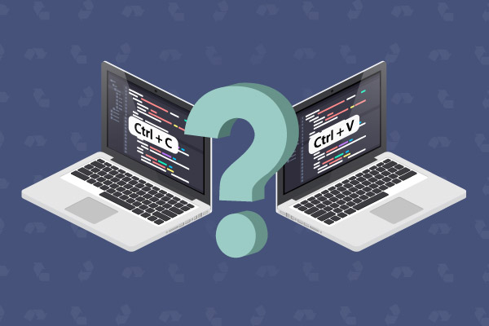

Slide 3
What ?
Code reuse is the practice of using existing code for a new function or software
Code reusability defines the methodology you can use to use similar code, without having to re-write it
E.g Open Source Lib

Slide 4
When ?
Easily extended and adapted for the new application
Ported to different hardware if needed
Code is free from defects or problems that affect the reliability, safety, or security of the new application

Slide 5
Approaches
Inheritance
use the base class's functions and members in other classes
Similar functions are reused
Function calls
create small code blocks of an algorithm or logic-based source code
ensure that every logic is written once

Slide 6
Libraries
Dynamic Link Libraries (DLL)
a set of compiled programs
libraries can be linked to your executable code
framework allows support of using and creating third-party libraries
Forking (Github)
forking is a process of using someone else's source code and making changes to it to fit your own needs
Component based design

Slide 7
Documentation
Documentation is the information that describes the product to its users
consists of the product technical manuals and online information
Earlier programmers and developers were doing documentation but now technical writers are required

Slide 8
Types
System Documentation
requirements document
software architecture documentation or design document
source code document
quality assurance documentation
User Documentation
release notes and installation guides
training manuals
user manuals
Online help

Slide 9
Documentation Standards
Documentation standards are rules and guidelines for creating, formatting, revising all documents on behalf of an organization
IEEE standards for system documentation IEEE 829-2008 and software user documentation 1063-1987

